Slide 1
What Should an ILS Do When Everything Continues to Change?
Penny Lochner, Muhlenberg College
2017 Annual Meeting
Potomac Technical Processing Librarians
Discovery & The Now Generation ILS: The Next Generation Is Here!
Notes:
Connecting library users with resources remains a core role for librarians. The continuing expansion of electronic resources in library collections, increasing variety of acquisitions models, open access resources, and interconnected services offer new challenges and opportunities for technical services staff. Trexler Library staff have been using OCLC WorldShare Management Services (WMS) and WMS Discovery since 2015. How has this impacted what we surface for our users and claim as part of our collections? Are we able to present all resources to our users and meet them where they are? Can we manage paid resources to maximize use of our budget and be mindful of the future? This presentation will review Trexler Library’s approach to discovery, the changing role of the technical resources unit, and our experience using an ILS in a cooperative environment.

Slide 2
Welcome to Trexler Library Opened in 1988

Slide 3
Student Population Compared to Library Staffing
Enrollment
2,408 student FTE
4 year undergraduate liberal arts, disciplinary and interdisciplinary majors/minors
Primarily residential students
Library Staff
Director
7 FT Librarians
2 FT Paraprofessional Managers
6 FT, 1 PT Staff Associates
46 Student Workers (6-7 hrs./wk. each)

Slide 4
Library Organization
Collection Resources Management
Acquisitions, cataloging, processing, serials, gov’t docs (FDLP). Oversight for collection development.
Lending and Borrowing Services
Circulation, Reserves, ILL
Public Outreach and Information Literacy
Reference & instruction, scholarly communication & special collections librarian. Oversight for institutional repository.
Administration
Includes library technology

Slide 5
What Should an ILS Do When Everything Continues to Change?
The history of library technology tracks alongside the prevailing technologies available in the general business and consumer sectors. Methods employed by libraries have constantly evolved.
--Marshall Breeding in Library Services Platforms: A Maturing Genre of Products, p.6

Slide 6
Timeline for Systems & Discovery at Trexler Library
“Encompass Search”
360 Search
WorldCat Local*
WorldShare Discovery
Discovery
2008
2012
2015
1986
1994
2006
2015
Systems
Innovative Interfaces INNOPAC
Innovative Interfaces Millennium
OCLC WorldShare
Management
Services (WMS)
OCLC LS/2000
*Hosted OCLC Ezproxy added 2012
Notes:
Library management system upgrades about 10 years apart. Search/Discovery much quicker development path. 3 systems in 7 years – federated search –> WCL/Millennium: discovery (central index), still have separate catalog/ILS -> WMS/WSD discovery integrated with catalog, circulation, acquisitions, ER management

Slide 7
Current WorldCat Holdings
1.25 million titles
Physical/ in-library: 360,341
Includes 59,020 Gov Docs (excluding microform)
Includes 82,118 Gov Docs in microform
Online : 896,078
Resource types: Books, Journals, Films, Music, Scores, Maps, Databases, Images, Kits, etc.

Slide 8
What Should an ILS Do?
Traditional ILS role
Integrate all aspects of managing library collections and collection services
At Trexler Library, we use all modules of the ILS – Circulation, ILL, Acquisitions, Cataloging, Inventory. No campus-wide accounting system (yet).

Slide 9
Library Collections Issues
Balancing Access vs. Ownership
Stability/continuity/quality of title list
Acquisition models increasing, evolving
Open access expanding, hybrid journals
Stewardship
Digitization
Tracking perpetual access/licensed content
The scholarly record

Slide 10
Improvements Desired in a New System
Comprehensive user discovery experience
More efficient record management with reduced redundancy in data entry
Electronic resource management for collections, databases and licenses integrated within the acquisition and resource maintenance workflow
Open platform that supports APIs and cooperative development among user community
Free up staff time for other projects
Manageable cost

Slide 11
Technology at Work
Each phase of libraries brings new operational tasks that benefit from technology, leading to new products to meet those needs.
--Marshall Breeding in Library Services Platforms: A Maturing Genre of Products

Slide 12
Connecting Library Users with Resources
Starting with WorldCat Local (maintained separate catalog)
Search includes current OCLC records, subject headings, and authorities.
Direct access to articles/chapters in addition to traditional bibliographic level access.
Faceted search results refinement.
Labels that use common terms.
Linked data brings together information from WorldCat, KB, and central index.
For items not held, alternate access offered.
Did not include all holdings.

Slide 13
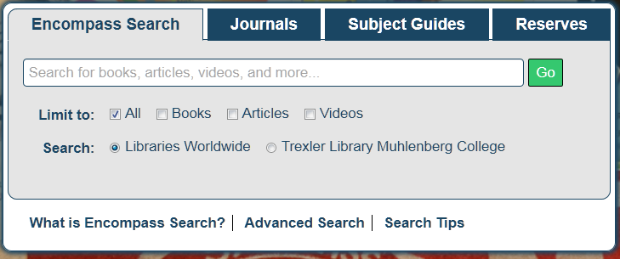
Moving to WorldShare Discovery (Encompass Search)
Single search with all resources & formats included
Focus groups on single search
Added optional facets to library search box

Slide 14
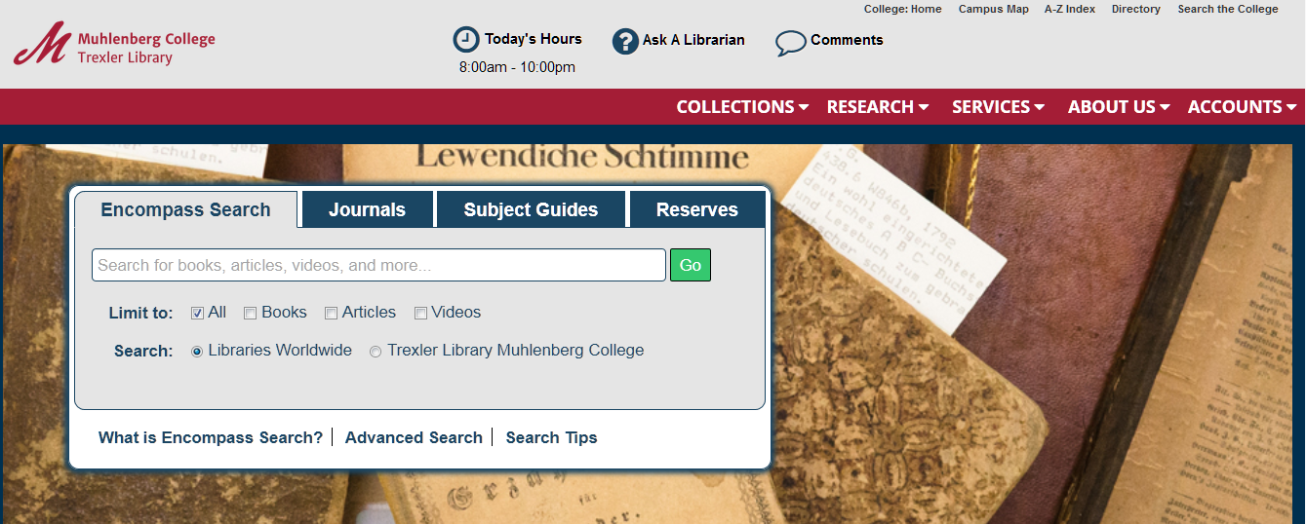
Encompass Search in Context http://trexler.muhlenberg.edu

Slide 15
Connecting Library Users with Resources
WMS+WSD discovery advantage
Comprehensive inclusion of resources. Minimizes silos. Previously, over 120,000 eBooks and streaming media were not in the local catalog. Many mismatches between WCL + local holdings.
Single set of OCLC records. No separate local catalog that is not reconciled with WorldCat.
Multiple formats combined in one search result.
Item location/status embedded in search result.
Acquisition order status displays on firm orders.
Resource Sharing is integrated with Circ.

Slide 16
Workflows
Moving to WMS simplified most workflows
Public Services
Technical Services
Acquisitions
Cataloging
Serials
Government Documents
Circulation
ILL/Resource Sharing
Reserves
Success depended on staff willingness to experiment with new possibilities.

Slide 17
Major Impacts on Collection Management Workflows
MARC record loading eliminated.
Acquisitions and cataloging more interconnected.
Need to consider that bibliographic/KB data is shared.
All staff learned to think about ER and physical resource organization separately. Facilitated by WMS structure.
Using knowledge base only for all electronic - no LHRs.
Increased work: vendor supplied data, and updating.
We are part of a collaborative effort.

Slide 18
Acquisitions & Cataloging
Physical resources are ordered by title using WorldCat records. Holdings marked.
If no record available, must create. Our Acquisitions Manager creates a brief bib.
Electronic resources are ordered by title or collection using the OCLC Knowledge Base.
If no title, add to existing custom collection.
If no collection, cataloger creates collection.

Slide 19
Acquisitions & Cataloging Gains
Use KBART comparisons to manage collections for PDA/EBA
To determine the value that a new collection will add
To remove overlap in PDA/EBA/subscription collections which controls STL/ATO costs.
Time for major collection projects
Missing items evaluation and replacement
VHS to DVD evaluation / ordering / withdrawal

Slide 20
Acquisitions
System flexibility
An invoice can be paid without an associated order, if desired.
Used for non-collection invoicing
Used first year with large/difficult collection orders to keep things moving.
Subscription renewal is separate from but linked to order and invoice records.
Accommodates vendor changes, renewal period changes, supplemental invoices.
r.

Slide 21
Acquisitions Gains
Streamlined workflows plus linked data shortened time spent processing.
Have time to handle more acquisition methods and evaluate/participate in consortial collective collecting agreements.
The system continues to be improved.

Slide 22
Cataloging
Standard WMS workflow folds processing and cataloging tasks into acquisitions receiving workflow.
We adapted the workflow to our staffing and kept final cataloging activity separate.
Less time spent on customizing locally.
Focus on special collections, original records.
More time spent on metadata standards to support acquisitions data entry & provide standardized metadata for user.

Slide 23
Cataloging Constraints
Bibliographic records are shared and any changes to them must be considered carefully.
Some MARC fields are not displayed in discovery.
Global changes by OCLC are out of our control. Impact on discovery mostly + but some -.
Format/resource type errors in leader data or specific fields can impact discovery.

Slide 24
Metadata Constraints
Knowledge Base title level records operate best in discovery when they include an OCLC number.
Some custom changes you make may be overwritten by vendor data feeds/updates.
Some vendors are slow to provide or can’t provide metadata.
MARC records > MARCedit > KBART

Slide 25
Knowledge Base Benefits
Collection – Title – KBART format provides great flexibility to customize collections to match our particular license/subscription.
Data feeds between vendors and OCLC limits need for us to update manually.
Easy to select open access collections.
Connects to license manager.

Slide 26
Metadata Librarian
Role changes
Coordinating with vendors to get new collections set up or records to build a collection.
Creating new KB collections.
OCLC number reconciliation, adding new.
Collection overlap.
Troubleshooting electronic resource access.

Slide 27
Impact on Collection Development
Fewer physical books being ordered because ebooks are easily accessed.
More time spent thinking about possible impact of different acquisition options
Supporting discovery
User confusion
Stewardship
Open access
Supporting hybrid journals

Slide 28
Statistics
Preformatted reports support assessment of WMS activity
Collection use, Discovery, Acquisitions, Cataloging
Add-on module: Report Designer allows us to create custom reports, including linking together fields from different data universes.
Early days: Still depend on technology librarian to create complex reports.
Metadata does not always match our needs.

Slide 29
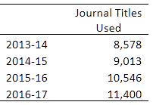
Developments in Use
Ebook use has exploded.
http://bit.ly/2xS8luE
Significant increase in number of journal titles being used.
Use of Google Scholar has increased.
---

Slide 30
Thank you
Questions?
Penny Lochner
pennylochner@muhlenberg.edu
Trexler.muhlenberg.edu

